Slide 1


Project number: 2023-1-CZ01-KA121-VET-000135958​
Matouš Sedlář​
M3.A​
63-41-M/01 Sports management and healthy lifestyle​
Thessaloniki, Greece 2024

Slide 2
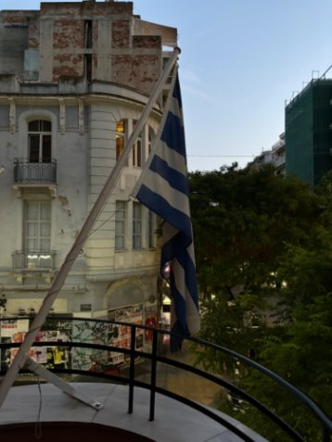
Content of presentation
Place of duration
Company
Organization structure of the company
Description of perfomed activies
Leisure activies
Benefits

Slide 3
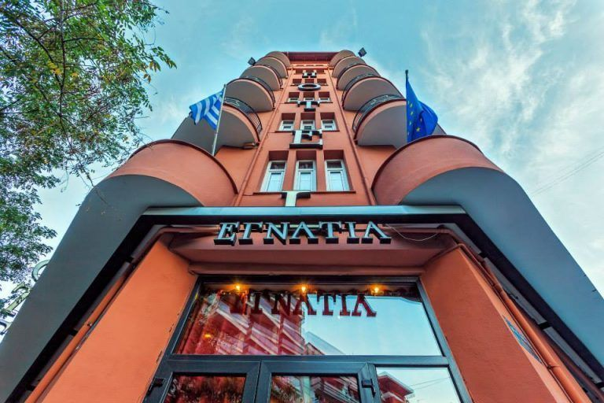
Place of stay
The hotel was located in Thessaloniki near the Egnatia street.
The place was gorgeous and most of the Street Art.

Slide 4
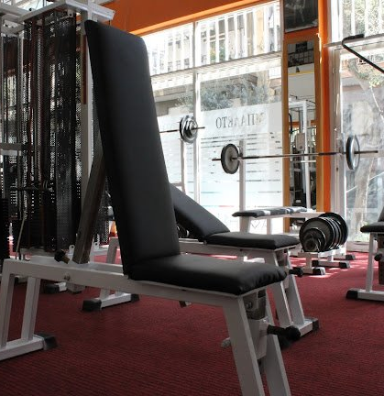
My work – Gym Athlisis
I´m very excited because fitness is my life.
Gym Athlisis is best fitness centre in Thessaloniki where people can go.
It has yoga room and room for lifting.
Owner is coach who has lot of experience.

Slide 5
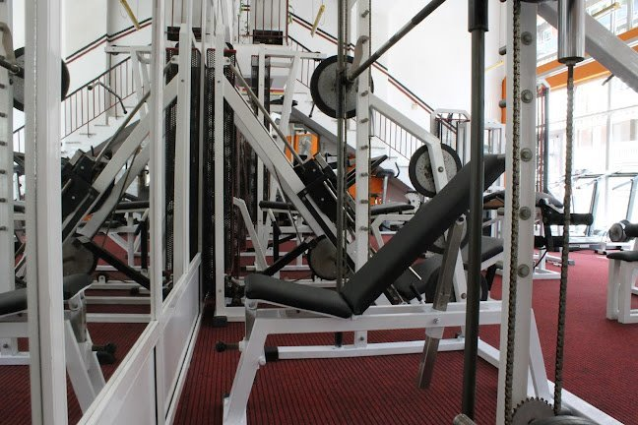
Organization structure
Owner
Trainer
Cleaner

Slide 6
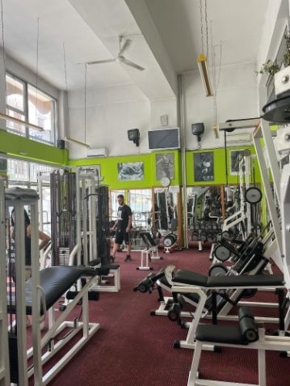
Perfomed Activities
We worked for 9 To 13 o´clock.
The owner taught me and my schoolmates how does it work in Greece with licences that people must have to own gym and train other people.
Owner teach me.
How to be a bodybuilder.
About nutrition and suplements.
Streching and about human, muscle, bones...

Slide 7
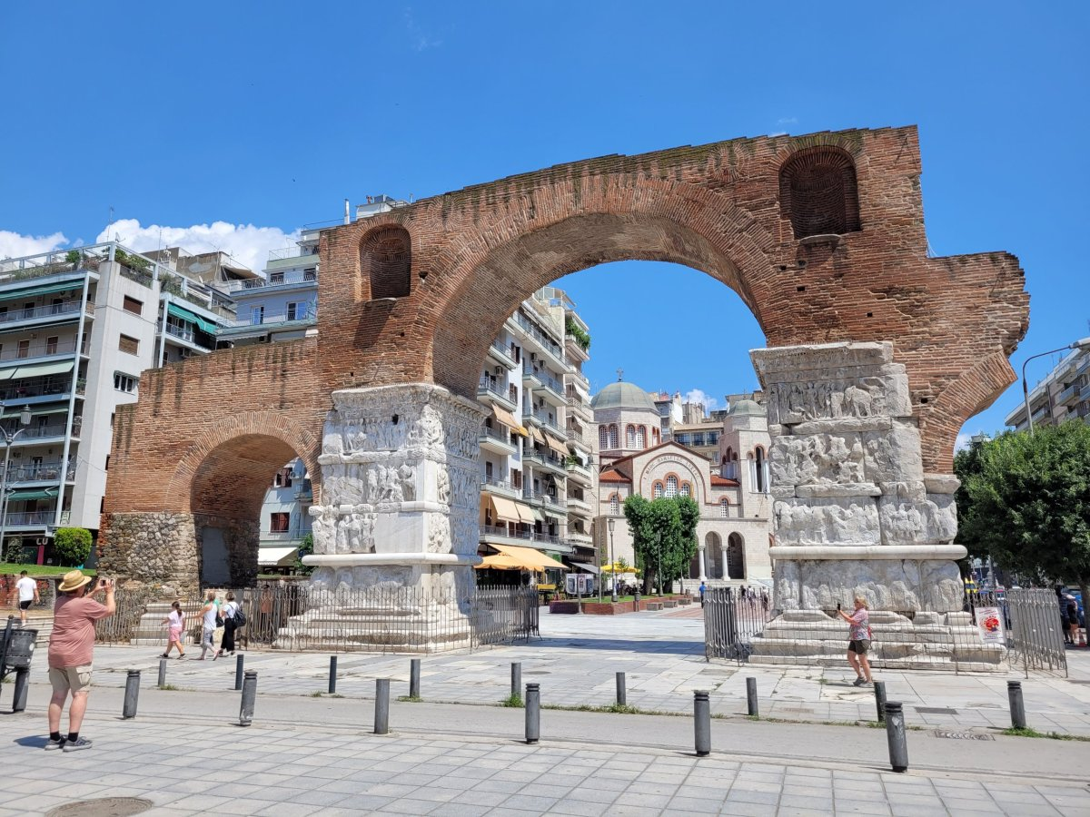
Leisure activities
In my free time i saw lot of monuments and i went to fishing in sea, I enjoy it very much.
I worked every day on my cardio activity, i must have 15 000 steps per day.

Slide 8
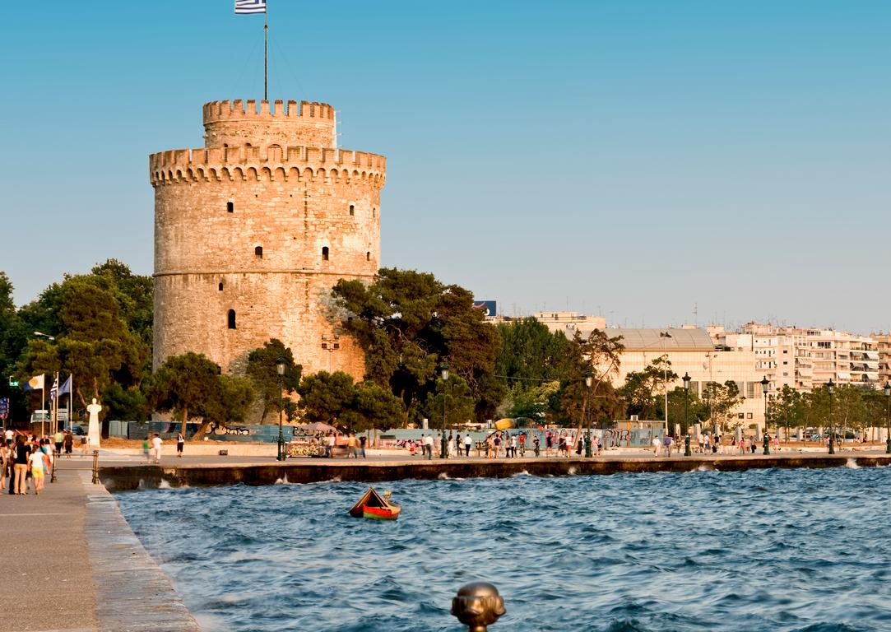
White Tower

Slide 9
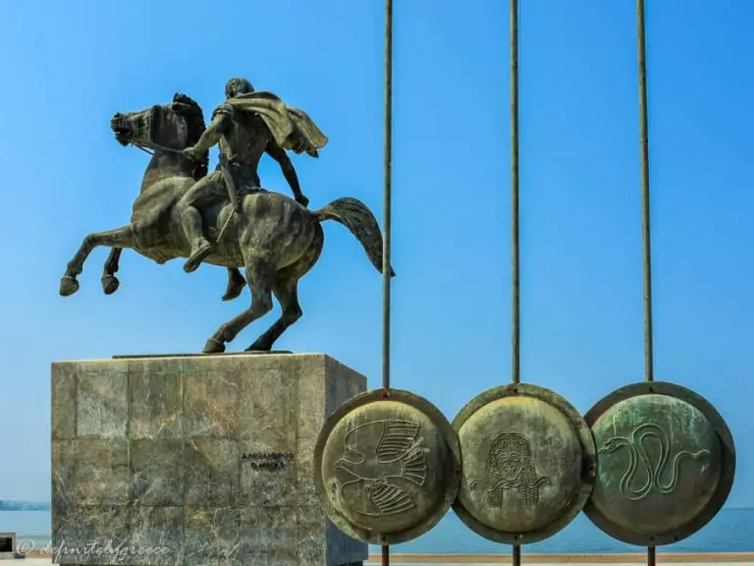
Statue of Great Alexander

Slide 10
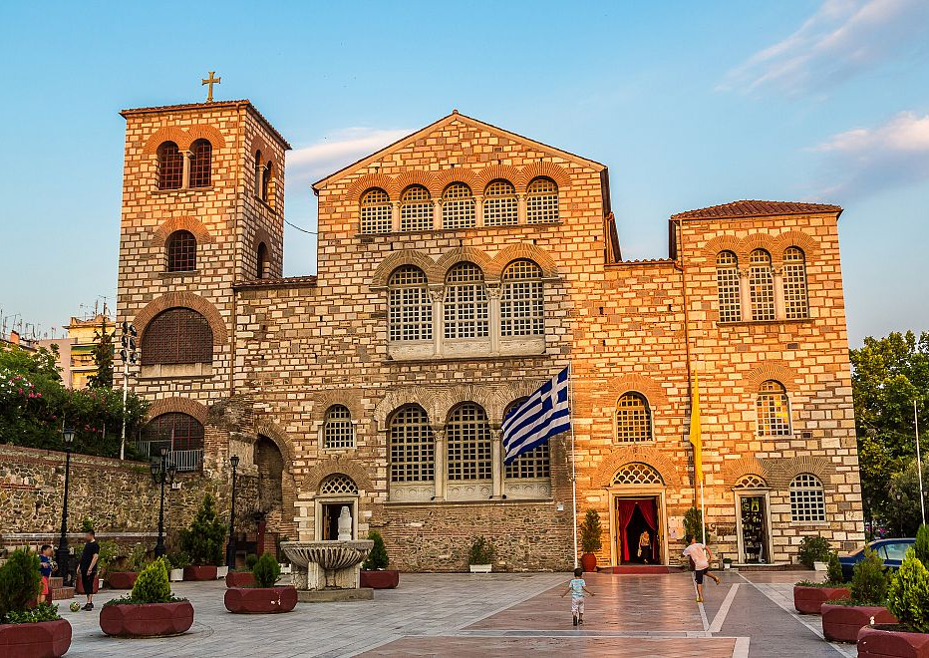
Basilica of St. Demetrius

Slide 11
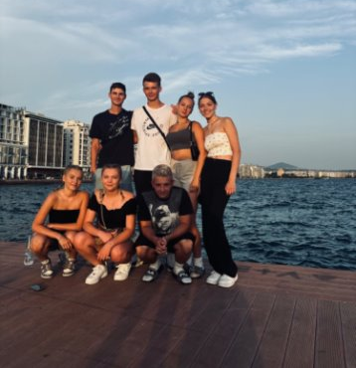
Acquired skills
I´ve improved my English language.
I earned experience with bodybuilding and coaching people.
I learned about Greek history.

Slide 12
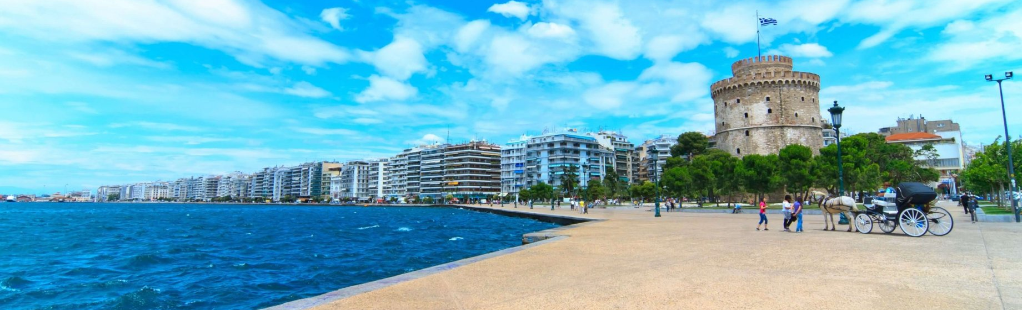
Thank you for your attention

Slide 13
Resources
www.radynacestu.cz
www.recko.tripzone.cz
www.krauzovinacestach.cz
SWOT Partners with Thessaloniki’s Egnatia Hotels | GTP Headlines

